Slide 1
Introduction to Emerging Technologies
Chapter Three
Artificial Intelligence (AI)

Slide 2
Outline
Definitions
History
Levels of AI
Types of AI
Influencers of Artificial Intelligence
Applications of AI
AI Tools and Platforms
Sample Applications

Slide 3
Introduction
In the previous chapter we have looked over data science, data acquisition, analysis and storage. Basic concepts of big data were also reviewed.
In this chapter; history, types, and applications of AI will be examined. Tools and platforms, as well as sample AI applications, shall be discussed.

Slide 4
Learning outcomes
After completing this chapter you should be able to:
Explain what artificial intelligence (AI) is.
Describe the ages of AI.
Explain the types and approaches of AI.
Describe applications of AI in health, agriculture, business and education.
List factors that influenced the advancement of AI in recent years.
Understand the relationship between human’s way of thinking and AI systems
Identify AI research focus areas.
Identify real-world AI applications, platforms, and tools.

Slide 5
AI Defined
Artificial Intelligence (AI) is a branch of computer science by which we can create intelligent machines which can behave like humans, think like humans, and are able to make decisions. (adopted by MOSHE)
AI is an umbrella term for “smart” technologies that are aware of and can learn from their environments. AI enables machines to sense their environments, think, learn and respond on their own, becoming increasingly autonomous. Governance Insights Center, 2017
Notes:
Artificial: man made, not natural
Intelligence: the ability to acquire and apply knowledge and skills. Oxford dictionary
AI is man-made ability to reason, learn and solve problems (or take appropriate actions to stimuli).
AI is the study of ideas that enable computers to be intelligent.
AI is the part of computer science concerned with design of computer systems that exhibit human intelligence. (The Concise Oxford Dictionary)
AI = Artefact + Intelligence
This generally involves borrowing characteristics from human intelligence, and applying them as algorithms in a computer friendly way.

Slide 6
Definitions Continued…
Machine learning (AI) allows computer systems to learn from data and recognize patterns, predict outcomes, assist humans with understanding or suggest actions (becoming “smart”) without being explicitly programmed.
Among other things, machine learning (AI) can inform decision-making and make process automation more flexible.
Notes:
Thus, AI is replicating human behavior in to machines in the way humans are behaving.
Machine Learning is about Using data to answer questions.
Using data = Training; Answer questions = Predictions / Inferences
Google search is an example of machine learning (AI).
Recommendation systems use machine learning algorithms.

Slide 7
Notes:
Source of this slide is MIT open courseware, which you can freely access online.
The bottom part of this picture (machine learning) represents the training aspect where the learning takes place using Big data [(data : output) pair] and it takes time to do that as compared to get the result of a test data as shown in the top part of the picture (traditional programming).

Slide 8
Definitions Continued…
Artificial Intelligence exists when machines can attain human-based skills such as learning, reasoning, and taking actions by their own.
Intelligence is composed of:
Reasoning
Learning
Problem Solving
Perception
Linguistic Intelligence
Notes:
Reasoning: The power of the mind to think, understand, and form judgments logically.
Learning: Knowledge or skills acquired through experience or study or by being thought.
Problem solving: Deciding what to do when one needs to think several steps ahead, for example playing chess.
Machine perception is the ability to use input from sensors (cameras, microphones, other sensors, etc.) to deduce aspects of the world. e.g., Computer Vision.
Linguistic Intelligence: For understanding natural languages, discover meaning

Slide 9
What are AI Systems? Systems that act like humans
The Turing Test approach
a human questioner cannot tell if
there is a computer or a human answering his question, via teletype (remote communication)
The computer must have behaved intelligently
Intelligent behavior
to achieve human-level performance in all cognitive tasks
Notes:
The Turing Test, proposed by Alan Turing (1950), was designed to provide a satisfactory operational definition of intelligence.
Turing defined intelligent behavior as the ability to achieve human-level performance in all cognitive tasks, sufficient to fool an interrogator.
Roughly speaking, the test he proposed is that the computer should be interrogated by a human via a teletype, and passes the test if the interrogator cannot tell if there is a computer or a human at the other end.
If it passes the test, we conclude it is an intelligent system.

Slide 10
What is Intelligence? The Turing Test
A machine can be described as a thinking machine if it passes the Turing Test. i.e. If a human agent is engaged in two isolated dialogues (connected by teletype say); one with a computer, and the other with another human and the human agent cannot reliably identify which dialogue is with the computer.
Notes:
The computer would need to possess the following capabilities to pass the test:
1. Natural language processing to enable it to communicate successfully in English (or some other human language);
2. knowledge representation to store information provided before or during the interrogation;
3. Automated reasoning to use the stored information to answer questions and to draw new conclusions;
4. Machine learning to adapt to new circumstances and to detect and extrapolate patterns.

Slide 11
The total Turing Test
Includes two more issues:
Computer vision
to perceive objects (seeing)
Robotics
to move objects and move over obstacles (acting)
Notes:
Other aspects of human intelligence can also be tested!
Computer Vision and Robotics are technologies where AI is applied widely.

Slide 12
Notes:
This picture needs an appropriate name; Such as, Parent disciplines and applications of AI
Root or Parent disciplines of AI:
Philosophy, Logic/Mathematics, Computation, Psychology/Cognitive Science, Biology/Neuroscience

Slide 13
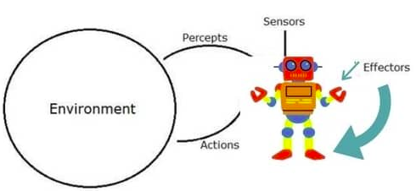
AI Systems (that act rationally)
An AI system can be visualized as composed of an agent and its environment. An agent (e.g., human or robot) is anything that can perceive its environment through sensors and acts upon that environment through effectors.
Intelligent agents must be able to set goals and achieve them.
Notes:
AI can be viewed as the study and construction of rational agents.
Acting rationally means acting so as to achieve one's goals, given one's beliefs.
Rational: based on or in accordance with reason or logic.
Intelligent agents must be able to set goals and achieve them (planning).
In classical or ideal cases (of planning to solve problems), the agent can assume that it is the only system acting in the world, allowing the agent to be certain of the consequences of its actions.
However, if the agent is not the only actor, then it requires that the agent can reason under uncertainty. This calls for an agent that cannot only assess its environment and make predictions but also evaluate its predictions and adapt based on its assessment.

Slide 14
AI Systems Continued…
High-profile examples of AI include autonomous vehicles (such as drones and self-driving cars), medical diagnosis, creating art (such as poetry), proving mathematical theorems, playing games (such as Chess or Go), search engines (such as Google search), online assistants (such as Siri), etc.
Notes:
Image recognition in photographs (Computer vision), spam filtering, prediction of judicial decisions and targeting online advertisements.
Different types of recommendations, friend suggestions in Facebook, fore example, and so on.

Slide 15
AI Systems Continued…
AI deals with the area of developing computing systems that are capable of performing tasks that humans are very good at, for example recognizing objects, speech recognition, and decision making in a constrained environment.
Machine Learning (ML) is an advanced form of AI where the machine can learn as it goes rather than having every action programmed by humans.

Slide 16
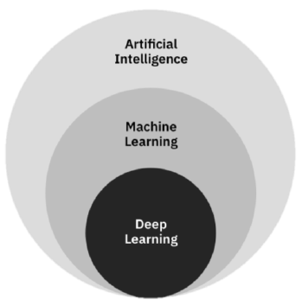
AI Systems Continued…
Relationships of AI, ML, and DL
Deep learning (DL) is a field of neural networks with several hidden layers.
Notes:
Deep learning replicates (imitates) the human neural system.
Neural networks are biologically inspired networks that extract features from data in a hierarchical fashion.

Slide 17
Need for Artificial Intelligence
To create expert systems that exhibit intelligent behavior with the capability to learn, demonstrate, explain and advice its users.
Helping machines find solutions to complex problems like humans do and applying them as algorithms in a computer-friendly manner.

Slide 18
Goals of Artificial Intelligence
Replicate human intelligence
Solve Knowledge-intensive tasks
An intelligent connection of perception and action
Building a machine which can perform tasks that requires human intelligence such as:
Proving a theorem
Playing chess (or other skill games)
Plan and execute some surgical operation
Driving a car in traffic

Slide 19
What Comprises of AI?
Intelligence is an intangible part of our brain which is a combination of Reasoning, learning, problem-solving, perception, language understanding, etc.
To impart these qualities into machines, Artificial Intelligence requires the following disciplines:
Mathematics
Biology
Psychology
Sociology
Computer Science
Neurons Study
Statistics
Notes:
AI is not only part of computer science, but it encompasses many disciplines as shown here.
Can AI systems have moral? Faith? Feelings? Is this an emerging AI?

Slide 20
Reading Assignment: Read about Advantages and Disadvantages of AI

Slide 21
History of AI
Artificial Intelligence is not a new discipline and not a new technology for researchers.
Milestones in the history of AI are shown in the following slide.

Slide 22
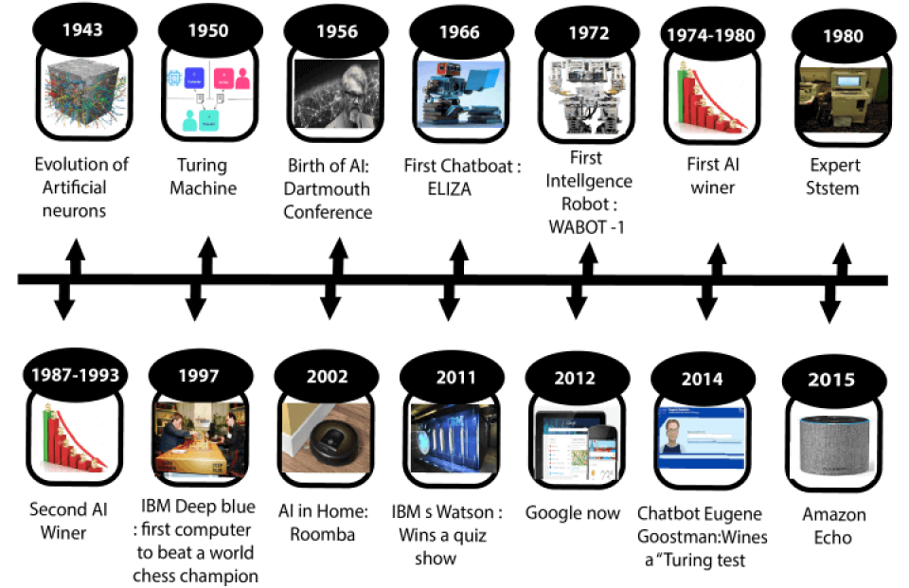
History of AI in pictures…
Winter
Winter
Notes:
1943: Model of artificial neurons was proposed;
1950: Alan Turing, an English mathematician pioneered Machine learning in 1950 and proposed the Turing test;
1956: the first AI program to prove 38/52 mathematical theorems and the term AI was adopted in USA at a conference;
1972: First humanoid robot developed in japan;
First and Second AI winters; The cold season (period for AI). Refers to the time period where computer scientists dealt with a severe shortage of funding from governments for AI researches. During AI winters, an interest in publicity on artificial intelligence was decreased.
1980: The first expert system was developed;
1993-2011: The emergence of intelligent agents;
2011-to date: Deep learning, big data and remarkable advances in artificial intelligence.
About 80 years since AI was considered as a main subject.

Slide 23
History of AI…
Now AI has developed to a relatively remarkable level. The concept of Deep learning, big data, and data science are now trending.
Companies like Google, Facebook, IBM, and Amazon are working with AI and creating amazing devices. The future of Artificial Intelligence is inspiring and much more is to come.

Slide 24
Levels of AI
As we have mentioned frequently, AI technology machines are designed to learn from their perceived environment’s data and to use past experiences to make proactive decisions.
And AI never emerged out of the blue or overnight but it has passed and is yet anticipated to pass through various stages (levels).
Notes:
Therefore, as you can understand from this, some lower levels are realized while higher levels are only predictions or likely realizable anticipations of the future.
What are these anticipated higher levels of AI?
There are seven levels of AI, in which the higher levels are strongly & possibly believed to be realized in the future.

Slide 25
Levels of AI
Level 1: Rule-Based Systems
The most common uses of AI today fit in this category, covering everything from business software (Robotic Process Automation) and domestic appliances through to aircraft autopilots.

Slide 26
Levels of AI …
Level 2: Context Awareness and Retention
Algorithms that develop information about specific domain of applications. These systems are trained on the knowledge and experience of the best people and the knowledgebase can be updated/upgraded as new situations and queries arise. Well, known applications of this level are chatbots and “roboadvisors”.

Slide 27
Levels of AI …
Level 3: Domain-Specific Expertise
Going beyond the capability of humans, these systems build expertise in a specific context using massive volumes of information for decision making. Successful use cases have been seen in cancer diagnosis and the well-known Google Deepmind’s AlphaGo.
Notes:
Only in a specific context, these machines are better than humans.
Currently, this type is limited to one domain only and would forget all it knows about that domain if you started to teach it something else.

Slide 28
Levels of AI …
Level 4: Reasoning Machines
These algorithms (models) have some ability to attribute mental states to themselves and others
Have senses of beliefs, intentions, knowledge, and know how their own logic works. This means they could reason or negotiate with humans and other machines.
Notes:
At the moment these models are still in development, however, commercial applications are expected within the next few years.

Slide 29
Levels of AI …
Level 5: Self Aware Systems / Artificial General Intelligence (AGI)
These systems have human-like intelligence – the most commonly portrayed AI in media – however, no such use is in evidence today.
Notes:
It is the goal of many working in AI to realize it from 2024.
They are working hard to make it happen starting 2024.
Artificial general intelligence (AGI) is the hypothetical ability of an intelligent agent to understand or learn any intellectual task that a human being can.

Slide 30
Levels of AI …
Level 6: Artificial Super Intelligence (ASI)
AI algorithms can outsmart even the most intelligent humans in every domain. Logically it is difficult for humans to articulate what the capabilities might be; yet we would hope examples would include solving problems we have failed to solve so far, such as world hunger and dangerous environmental & climate changes.
Notes:
Solve climate change problems, Natural disaster solutions, World peace solutions (or will it work the opposite?), and so on.
Such systems might also invent new fields of science, redesign economic systems, and evolve wholly new models of governance.
Views vary as to when and whether such a capability could even be possible, yet there are few experts who claim it can be realized by 2029. Fiction has dealt with this idea for a long time.

Slide 31
Levels of AI …
Level 7: Singularity and Transcendence
This is the idea that development provided by ASI (Level 6) leads to a massive expansion in human capability. Human augmentation could connect our brains to each other and to a future successor of the current internet, creating a “hive mind” that shares ideas, solves problems collectively, and even gives others access to our dreams as observers or participants.
Notes:
Pushing this idea further, we might go beyond the limits of the human body and connect to other forms of intelligence on the planet – animals, plants, weather systems, and the natural environment.
Transcendence: God like behaviors. Not realizable in normal human experience. Go beyond the range or limits of humans.
Some proponents of singularity such as Ray Kurzweil, Google’s Director of Engineering, suggest we could see it happen by 2045 as a result of exponential rates of progress across a range of science and technology disciplines.
The other side of the fence argues that singularity is impossible and human consciousness could never be digitized.

Slide 32
Reading Assignment:
Read about Kurzweil’s Predictions.
Notes:
Ray Kurzweil: Google’s director of engineering.
Has proposed (suggested) interesting predictions on the future of AI.

Slide 33
Types of AI
AI can be divided into various types, mainly into two types of categorization which are based on capabilities and evolution of AI view points, as shown in the diagram in the following slide.
Notes:
From different perspectives (angles or viewpoints), AI can be seen as divided into two types or categories.
 based on the strength of intelligence or capabilities, and  based on Evolution of AI (David Peterson).
Based on Capability (or Maturity Level)→ Based on what they are capable (clever) of doing → Based on strength of intelligence.
Based on Evolution of AI → Based on what services they provide through time as they evolve.

Slide 34
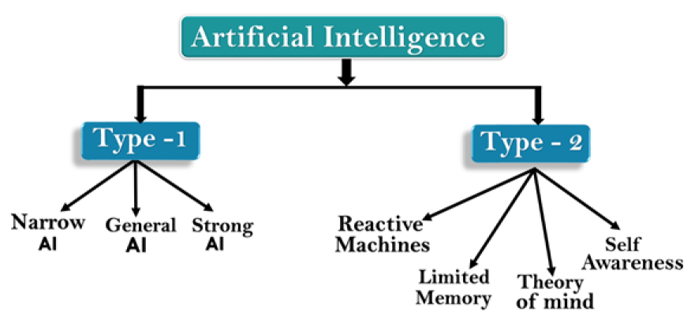
Types of AI
Notes:
Category 1 (Type 1) & Category 2 (Type 2)
Type 1: Based on Capability → Based on strength of intelligence.
Type 2: Based on Evolution of AI → Based on what services they provide through time as they evolve.
The expectations – and fears – regarding AI are great. Unfortunately, the current discussion does not make a distinction between what we have now (i.e., “narrow AI”), what the researchers are studying (i.e., “general AI”), and what futurists and sci-fi writers envision (i.e., “super AI”). We try to make this distinction by describing the characteristics of the three maturity levels of AI.

Slide 35
Type 1: Based on Capabilities
Weak or Narrow AI: is a type of AI which is designed to perform a dedicated task with intelligence. The most common and currently available AI is Narrow AI. It cannot perform beyond its field or limits, as it is only trained for a specific task.
Notes:
Narrow AI can fail in unpredictable ways if it goes beyond its limits.
Self-driving cars and virtual assistants, like Siri, are examples of Weak AI.
Apple Siri is a good example of Narrow AI, and it operates with a limited pre-defined set of capabilities.
IBM's Watson (supercomputer) also comes under Narrow AI, as it uses an Expert system approach combined with Machine learning and natural language processing.
Other examples of Narrow AI are Google translate, playing chess, purchasing suggestions (or recommendations) on e-commerce sites, speech recognition, and image recognition.
Weak AI relies on human interference to define the parameters of its learning algorithms and to provide the relevant training data to ensure accuracy.
Humans can possess a body of knowledge and can add more with no problem, unlike this category of AI.

Slide 36
Type 1: Based on Capabilities
General AI: This is a type of intelligence that could perform any intellectual task with efficiency, like a human. The idea behind general AI is to make a system that could be smart and think like a human on its own.
Notes:
General AI aims to create intelligent machines that are indistinguishable from the human mind. But just like a child, the AI machine would have to learn through input and experiences, constantly progressing and advancing its abilities over time.
Weak AI can perform only one type of task, whereas Strong AI can perform a variety of functions, eventually teaching itself to solve for new problems like humans.
While human input accelerates the growth phase of General AI, it is not required, and over time, it develops a human-like consciousness, instead of simulating it like Weak AI.
Currently, there is no such existing system which could come under general AI that can perform any task as seamless as a human.
It may arrive within the next 20 years but it has challenges relating to hardware, energy consumption required in today’s powerful machines, and the need to solve catastrophic memory loss that affects even the most advanced deep learning algorithms of today.
Researchers are currently focused on developing machines with General AI.

Slide 37
Type 1: Based on Capabilities
Super (Strong) AI: This is a level of Intelligence at which machines could surpass human intelligence, and can perform tasks better than humans with cognitive properties. This refers to aspects like general wisdom, problem solving and creativity.
Notes:
Some key characteristics of strong AI include capability to think, to reason and solve puzzles, make judgments, plan, learn, and communicate independently.
Super AI is essentially an outcome of General AI.
Super AI is still a hypothetical concept of Artificial Intelligence. If successful, it could definitely be highly disruptive.
According to weak AI, the principal value of the computer in the study of the mind in that it gives us a very powerful tool.
For example, it enables us to formulate and test hypothesis (model) in a more rigorous and precise fashion.
But according to strong or general AI, the computer is not just a tool in the study of the mind; rather, the appropriately programmed computer is a mind itself.

Slide 38
Type 2: Based on Evolution of AI
Reactive Machines: These are the most basic types of AI currently developed.
Do not store memories of past experiences for future use.
Only focuses on current scenarios and react with their best possible options.
IBM's Deep Blue system & Google’s AlphaGo are example of reactive machines.
Notes:
Reactive machines are programmed for the here and now, but not the before and after.
Has no concept of past or future.
There is no growth with reactive machines, only stagnation in recurring actions and behaviors.
IBM's Deep Blue system is an example of reactive machines.
Google's Alpha-Go is also an example of reactive machines.

Slide 39
Type 2: Based on Evolution of AI
Limited Memory: These machines can store past experiences or some data for a short period of time.
Self-driving cars are one of the best examples of such systems.
Notes:
These cars can store recent speeds of nearby cars, distance of other cars, speed limits, and other information to navigate the road.
Autonomous vehicles, or self-driving cars, use the principle of limited memory in that they depend on a combination of observational and pre-programmed knowledge. To observe and understand how to properly drive and function among human-dependent vehicles, self-driving cars read their environment, detect patterns or changes in external factors, and adjust as necessary.
Despite the ability to far outdo typical human performance in certain tasks limited memory machines lag behind human intelligence in other respects.
They require huge amounts of training data to learn tasks humans learn with just a few examples, and they are vulnerable to outliers or adversarial examples.

Slide 40
Type 2: Based on Evolution of AI
Theory of Mind: This type of AI would understand human emotions, beliefs, and be able to interact socially like humans.
Notes:
This type of machines are not still realized, but researchers are making lots of efforts and progress is being made.
What constitutes theory of mind is decision-making ability equal to the extent of a human mind, but by machines.
While there are some machines that currently exhibit humanlike capabilities (voice assistants, for instance), none are fully capable of holding conversations relative to human standards.
Some elements of theory of mind AI currently exist or have existed in the recent past.
Two notable examples are the robots Kismet and Sophia, created in 2000 and 2016, respectively.
These two humanlike robots are samples of movement toward full theory of mind AI systems materializing in the near future.
While neither fully holds the ability to have full-blown human conversation with an actual person, both robots have aspects of emotive ability akin to that of their human counterparts – one step toward seamlessly assimilating into human society.

Slide 41
Type 2: Based on Evolution of AI
Self-Awareness: This type of AI is the future of Artificial Intelligence. These machines will be super intelligent and will have their own consciousness, sentiments, and self-awareness.
Notes:
These machines will be smarter than the (average) human mind.
Self-Awareness AI is a hypothetical concept and does not exist in reality at this moment.
Self-aware AI involves machines that have human-level consciousness. This form of AI is not currently in existence, but would be considered the most advanced form of artificial intelligence known to man.
Facets of self-aware AI include the ability to not only recognize and replicate humanlike actions, but also to think for itself, have desires, and understand its feelings. Self-aware AI, in essence, is an advancement and extension of theory of mind AI.
Where theory of mind only focuses on the aspects of comprehension and replication of human practices, self-aware AI takes it a step further by implying that it can and will have self-guided thoughts and reactions.

Slide 42
Activity
From our discussions, General AI could perform intellectual tasks with comparable efficiency to humans. So, to achieve this level of intelligence, do you think that future AI must mimic the way humans think? Why and why not?
Notes:
Can you imagine any other way of achieving human comparable intelligence, other than mimicking humans?
Intellect: the faculty (talent) of reasoning and understanding objectively (based on facts, not subjectively), especially with regard to abstract matters.

Slide 43
Mapping Human’s Thinking to AI Components
So, AI was defined as:
The study of ideas that enable computers to be as intelligent as humans.
Part of computer science concerned with design of computer systems that exhibit human intelligence. (Concise Oxford Dictionary)
Notes:
So, what we are going to do to impart intelligence into machines is to mimic human intelligence, because that is the kind of intelligence we only know about!

Slide 44
Mapping Human’s Thinking to AI Components
From the previous two definitions, we can see that AI has two major roles
Study the intelligent part concerned with humans.
Represent those qualities (components) using computers.
Notes:
What are the components (attributes/characteristics/qualities) of intelligence?
Reasoning, Learning, Problem Solving (or Taking Actions), Perception, Linguistic Intelligence
We will emulate (duplicate) human intelligence using machines by doing the following:
1. Study the intelligent characteristics concerned with humans.
[Q] How can you achieve this and who is responsible? Using the corresponding sciences and experts of those sciences.
Philosophy, Logic, Cognitive Science, Neuro Science, Information Science, etc.
2. Represent those qualities using computers. [Q] Who is responsible to do this? Computer scientists and software engineers.
Thus, by mapping human’s way of thinking to AI components.

Slide 45
How Do Humans think?
Intelligence or the cognitive process is composed of three main stages:
Observe and enter input information or data to the brain (sensing).
Interpret and process the perceived input, and evaluate the outcome.
Take actions or make decisions based on your cognition of the whole process.
Notes:
AI researchers are simulating the same stages in building AI systems or models.
This process represents the three main layers or components of AI systems.
Sensing layer, Interpretation layer (Reasoning & Thinking layer…), and Interacting (action) layer.

Slide 46
Influencers of AI
Big data
Advancements in computer processing speed and new chip architectures
Cloud computing and APIs
Emergence of data science
Notes:
Some of the reasons why AI is taking off (getting momentum) now is because of these drivers.
Big data refers to huge amounts of data (as a result of IR4). Big data requires innovative forms of information processing to draw insights, automate processes, and help decision making. Thus, it requires AI. Big data is one of the drivers of AI.
The exponential growth of unstructured and semi-structured data drives the need for a new kind of computer system. Like distributed clustered computing and AI.
In the past, one of the barriers to the growth of AI was lack of data availability.

Slide 47
Influencers of AI
Big data
Advancements in computer processing speed and new chip architectures
Cloud computing and APIs
Emergence of data science
Notes:
[Q] Why does the advancement in computer processing speed (or power) and architecture influence AI?
Advancements in computer processing and memory speeds enable us to make sense of the information that is generated by big data more quickly.
High processing power requirements of AI, machine learning, and deep learning.
CPU → GPU → TPU
Tensor Processing Unit abbreviation TPU is a custom-built integrated circuit developed specifically for machine learning and tailored for TensorFlow, Google's open-source machine learning framework.

Slide 48

Notes:
What is the cloud? What is cloud computing?
"The cloud" refers to servers that are accessed over the Internet, and the software and databases that run on those servers.
Cloud servers are located in data centers all over the world.
Cloud computing is a general term that describes the delivery of on-demand services, usually through the internet, on a pay-per-use basis.
By using cloud computing, users and companies don't have to manage physical servers themselves or run software applications on their own machines.

Slide 49
Influencers of AI Cont.
Big data
Advancements in computer processing speed and new chip architectures
Cloud computing and APIs
Emergence of data science
Notes:
Companies worldwide offer their services to customers over cloud platforms. These services might be data analysis, social media, video storage, e-commerce, and AI capabilities that are available through the internet and supported by cloud computing.
Cloud computing is a general term that describes the delivery of on-demand services, usually through the internet, on a pay-per-use basis.

Slide 50
Influencers of AI
Big data
Advancements in computer processing speed and new chip architectures
Cloud computing and APIs
Emergence of data science
Notes:
Application programming interfaces (APIs) expose capabilities and services. (Service Outlets).
Based on the principle of Service Oriented Architecture (SOA) style. Composition & Orchestration.
APIs enable software components to communicate each other easily.
APIs abstract the underlying workings of a service, application, or tool, and expose only what a developer needs, so programming becomes easier and faster.

Slide 51
Influencers of AI Cont.
All the big companies in the AI services market deliver their services and tools on the internet through APIs over cloud platforms:
IBM delivers Watson AI services over IBM Cloud.
Amazon AI services are delivered over Amazon Web Services (AWS).
Microsoft AI tools are available over the MS Azure cloud.
Google AI services are available in the Google Cloud Platform.
Notes:
These services benefit from cloud platform capabilities such as: Availability, Scalability, Accessibility, Rapid deployment, flexible billing options, simpler operations, and management.
IBM Watson: It is a question answering computer system capable of answering questions posed in natural languages.

Slide 52
Influencers of AI
Big data
Advancements in computer processing speed and new chip architectures
Cloud computing and APIs
Emergence of data science
Notes:
As we already know data science is about the extraction of knowledge from big data.
After large volume of data is collected, patterns emerge. Then, data scientists use learning algorithms on these patterns to extract knowledge.
Data science uses machine learning and AI to process big data. Thus, influencing AI.

Slide 53
Reading Assignment:
Applications of AI (Section 3.6 of module) This part is left as a reading assignment for you.

Slide 54
AI Tools and Platforms
AI platforms are defined as sorts of hardware architectures and/or software frameworks, that allows AI software to be initialized, trained, tested and deployed.
Notes:
What do you know about a platform? Why do we need platforms?
Can you name some platforms you used previously or you know about?
For example, Software Development Platforms? Can be JEE and Microsoft .NET Platforms.
Hardware architectures: Like GPU & TPU (Tensor Processing Unit);
Software frameworks: In computer programming a framework can be defined as a tool which makes easier to develop software and create systems.
AI platforms simulate the cognitive function that human minds perform such as problem-solving, learning, reasoning, social and general intelligence.
AI platforms are made up of tools and algorithms.
Framework: It’s software but written by someone else for you to use to develop your own software.
So that you can reuse components and alleviate the need to reinvent the wheel.

Slide 55
The purpose of software framework is to simplify the development environment, allowing developers to dedicate their efforts to the project requirements, rather than dealing with the framework’s routine, repetitive functions and libraries.
For example, rather than creating a VoIP application from scratch, a developer using a framework can concentrate on adding user-friendly buttons and menus, or integrating VoIP with other applications.

Slide 56
AI Tools and Platforms
An AI platform is a set of services that support the machine learning life cycle. This includes support for gathering and preparing data as well as training, testing, and deploying machine learning models for applications at scale.
Notes:
Artificial intelligence (AI) platforms provide users a tool kit to build intelligent applications.
AI platforms encompass components that enable visual and conversational design work for an AI solution.
These platforms combine intelligent, decision-making algorithms with data, which enables developers to create AI business solutions.
Some platforms offer pre-built algorithms and simplistic workflows with features like drag-and-drop modeling, and visual interfaces that easily connect necessary data to the end solution.
These algorithms can include functionality for image recognition (useful for criminal identification app development, for example), NLP (gives machines the ability to read/sense and understand human languages).
Some applications of NLP include information retrieval, text mining, question answering, machine translation, and voice recognition.

Slide 57
AI Tools and Platforms
AI platforms are frequently used by developers to create both the learning algorithms and intelligent applications.
Notes:
But, users without intensive development skills will benefit from the platforms’ pre-built algorithms and other features that minimize the learning curve.
AI platforms are very similar to Platforms as a Service (PaaS), which allow basic application development, but these products differ by offering machine learning options.

Slide 58
AI Tools and Platforms
AI has developed a large number of tools to solve the most difficult problems in computer science, such as:
Search and optimization
Logic
Probabilistic methods for uncertain reasoning
Classifiers and statistical learning methods
Neural networks
Control theory
Natural Languages and Cognition
Notes:
Thus, there are readymade tools to be used by developers provided by the platform.
Through optimized search, we are not only seeking for an answer, but for the best answer.
Logic: the quality of being justifiable by reason.
: reasoning conducted or assessed according to strict principles of validity.

Slide 59
Search
Search is a fundamental technique (procedure) of AI.
Possible answers, decisions or courses of actions are structured into an abstract space, which we then search.
Search is either "blind" or “informed":
Blind Search
we move through the space without worrying about what is coming next, but recognising the answer if we see it
Informed Search
we guess what is ahead, and use that information to decide where to look next.
We may want to search for the first answer that satisfies our goal, or we may want to keep searching until we find the best answer.
Notes:
If we consider search, for example, an AI platform provides a tool to answer search requests, and may follow steps shown here to do that.
**The last bullet can be considered as optimized search.

Slide 60
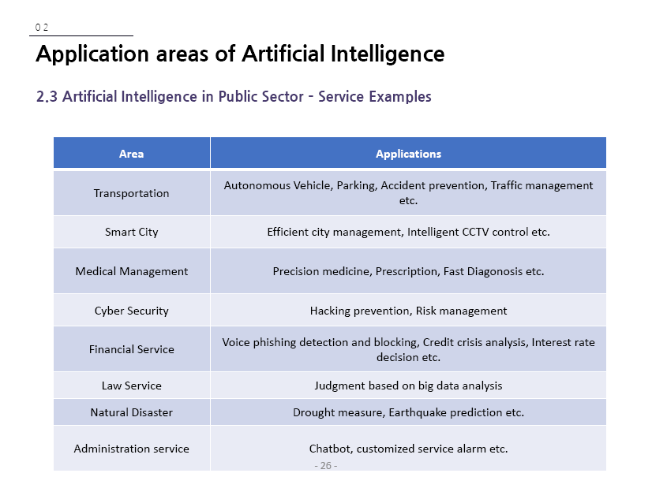

Example AI Applications
Notes:
[Q] What are the characteristics of a smart city? What makes a city smart?
Smart: Connected, safe, managed, convenient for its residents in all aspects.
All services are easily available, efficient and are supported by Information Communication Technologies.
All Services are IoT and AI supported.
Efficient Transportation can be considered as one component of smart city.
You can try most of these AI applications as a project using open platforms and frameworks.

Slide 61
Sample AI Applications
Commuting
Google’s AI Platform Predictions
Ridesharing Apps Like Uber and Lyft
Commercial Flights Use an AI Autopilot
Notes:
Google launched AI Platform Predictions in general availability, a service that lets developers prep, build, run, and share machine learning models in the cloud.
Google Maps Driving Mode estimates where you are headed and helps you navigate the surrounding area.
Google Search Engine is powered by AI.
These apps work worldwide, so you can count on Uber to get you home even if you’re in a foreign country.
We have mentioned the Autopilot thing many times.

Slide 62
Sample AI Applications
Email
Spam Filters
Smart Email Categorization
Social Networking
Online Shopping
Smartphone Features
Notes:
[Q] What does Facebook use AI for?
Pinterest uses computer vision (an AI application where computers are taught to see) to recommend similar objects in images.
Instagram uses machine learning to identify the contextual meaning of emoji (for example, a laughing emoji could replace “lol”).
And So On…

Slide 63
Sample AI Applications
Email
Social Networking
Online Shopping
Search
Recommendations
Smartphone Features
Notes:
Search - Amazon searches, for example, quickly return a list of the most relevant products related to your search.
We have said that search is an important AI platform tool or AI feature.
Recommendations - Amazon uses artificial neural networks to generate product recommendations.
Using phrases like “customers who viewed this also viewed” and “customers who bought this also bought”
Voice-to-Text: Currently a standard feature on smartphones. This is an AI aspect.
Thus, basic conversation (voice command) has become the control interface for a new generation of smart personal assistants.
Examples are Siri, Google Now, Google Assistant, Alexa which has question answering capabilities via internet searches.
Echo smart speakers allow you to integrate Alexa into your living room and use voice to ask natural language questions, and use voice commands to play music, order pizza, signal (hail) an Uber to stop, and integrates with smart home devices.

Slide 64
Assignment 2
Make a research online and submit a document (hard copy) on how Ridesharing Apps Uber and Lyft are working. Also describe platforms and frameworks available to develop such systems in your document. Is it possible, given your current level of knowledge, to develop ridesharing apps using open platforms and frameworks? Can you try and demonstrate a prototype?
Work in groups comprising of 3 students. Deadline: 23 July 2021.
Notes:
If you are the designer of your work, it will be unique.
Try to follow document writing structure rules as much as possible.
Such as, introduction, discussion, conclusion, references.
Your cited references should be accessible.
Cite (mention) your source whenever you use the work of others, and that is right thing to do.

